Slide 1

Supply Chain Inventory Management for Automotive Distributors
Group #14
Sharun Sanket Gayatri
Shruthi
Project For DAMG6210 - Data Management and Database Design
Under the guidance of Manuel D Montrond

Slide 2

Project Highlights
Complex Data Models for Reduced Redundancy
Constraint Checks for Ensuring Correctness of Data
Triggers for Auto-Updating Related Tables (e.g. Stock Update)
GUI for browsing data powered by Prisma

Slide 3

Design Documents

Slide 4
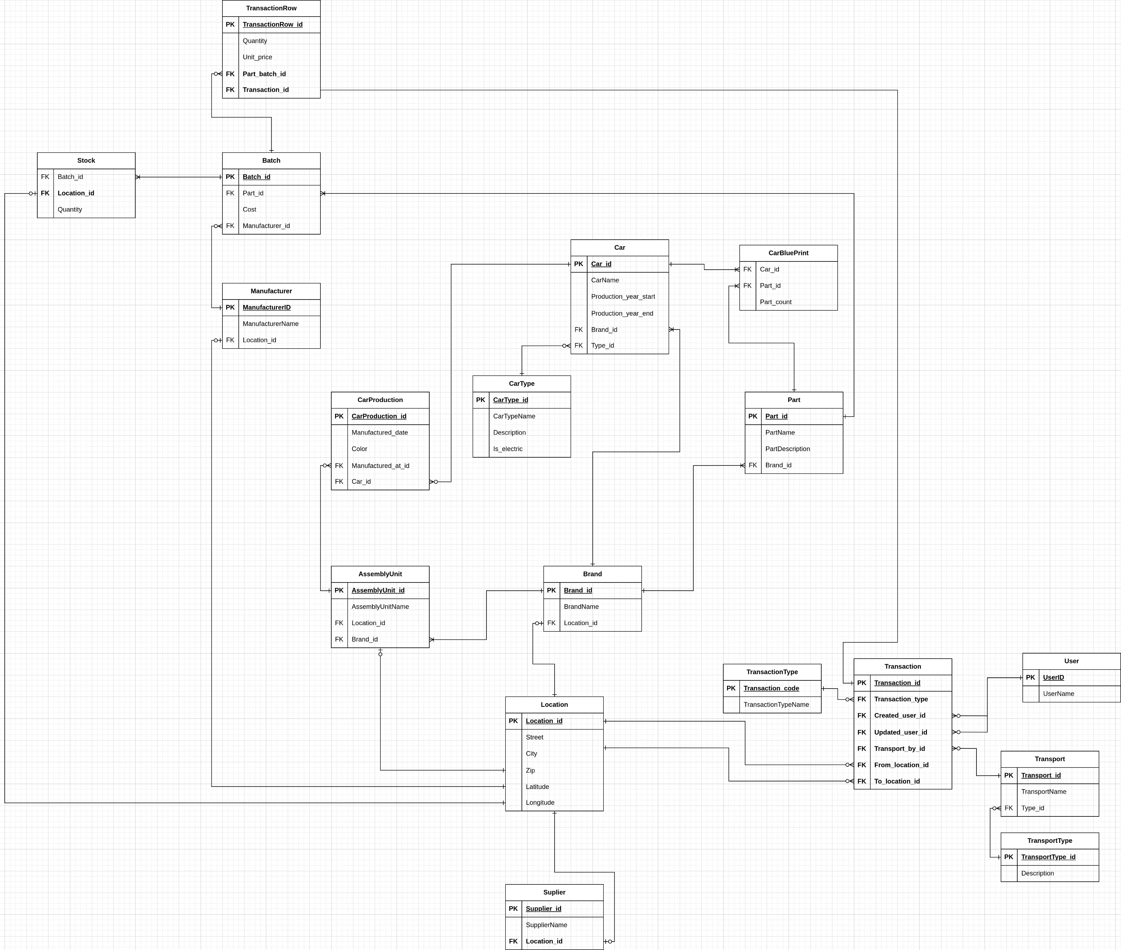
Final ERd
ERD Link: https://github.com/sharunkumar/DAMG6210/blob/main/diagrams/erd.png

Slide 5
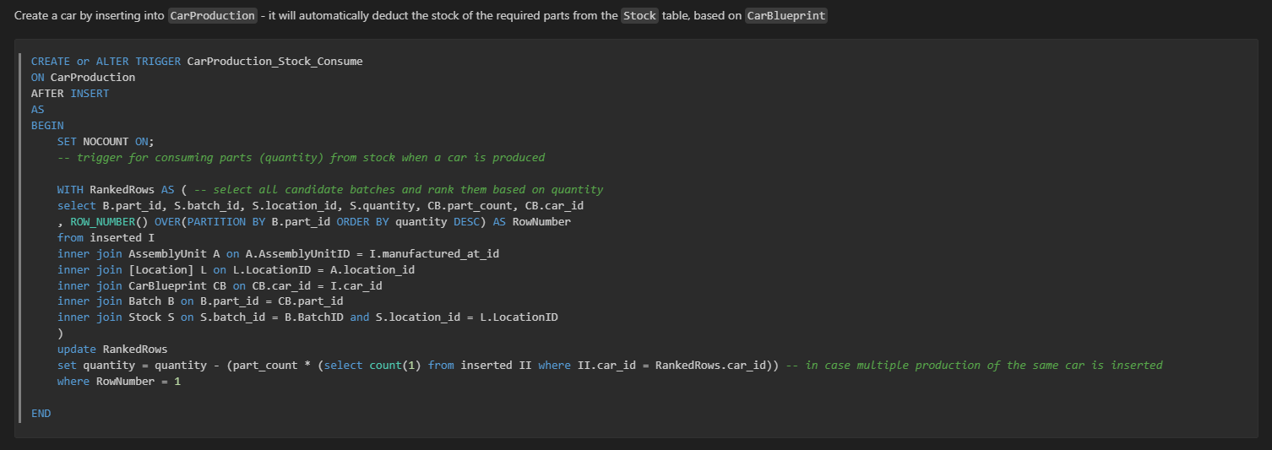
Trigger highlight - CarProduction

Slide 6
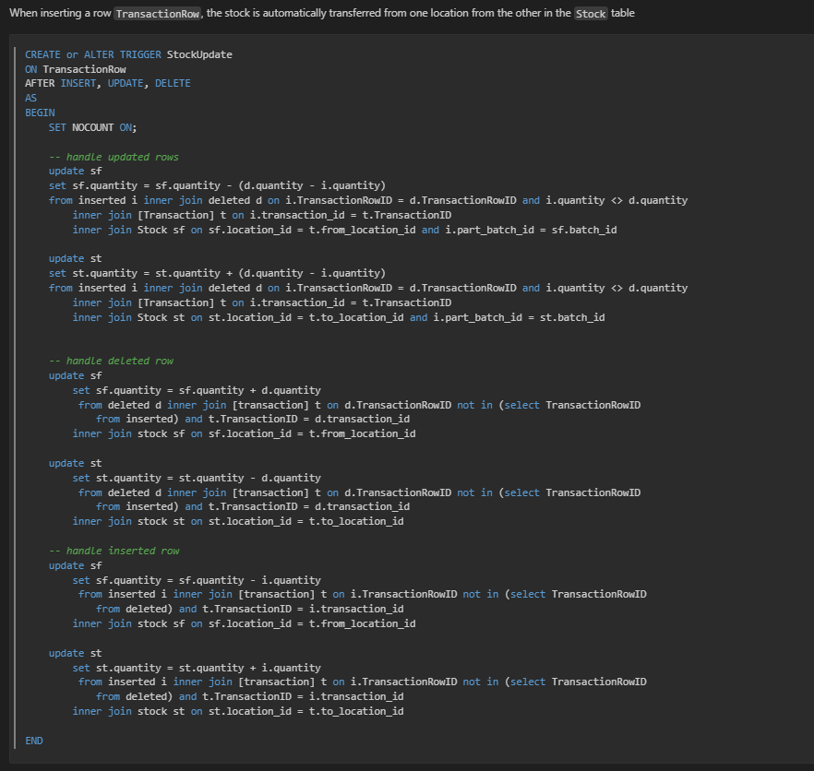
Trigger highlight – stock update

Slide 7
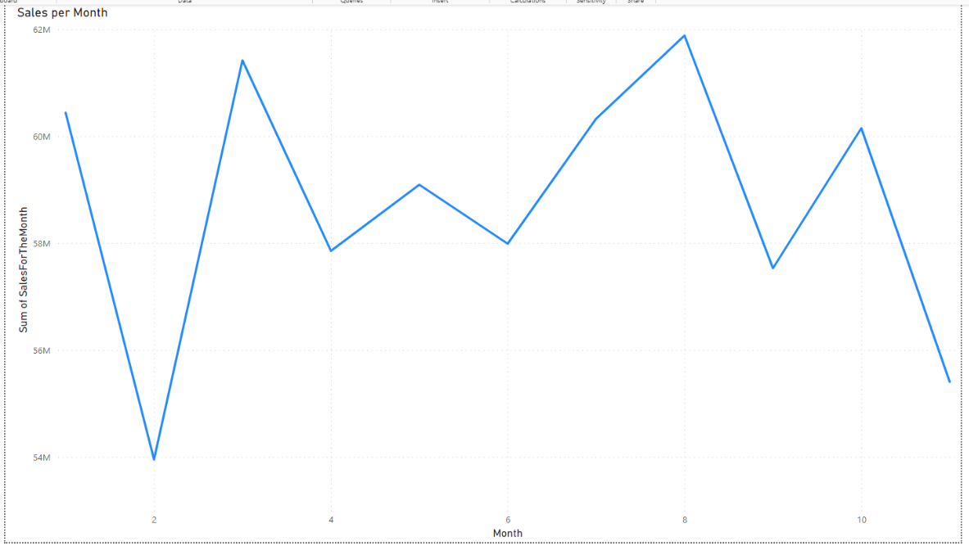
Visualization – Sales Per Month

Slide 8
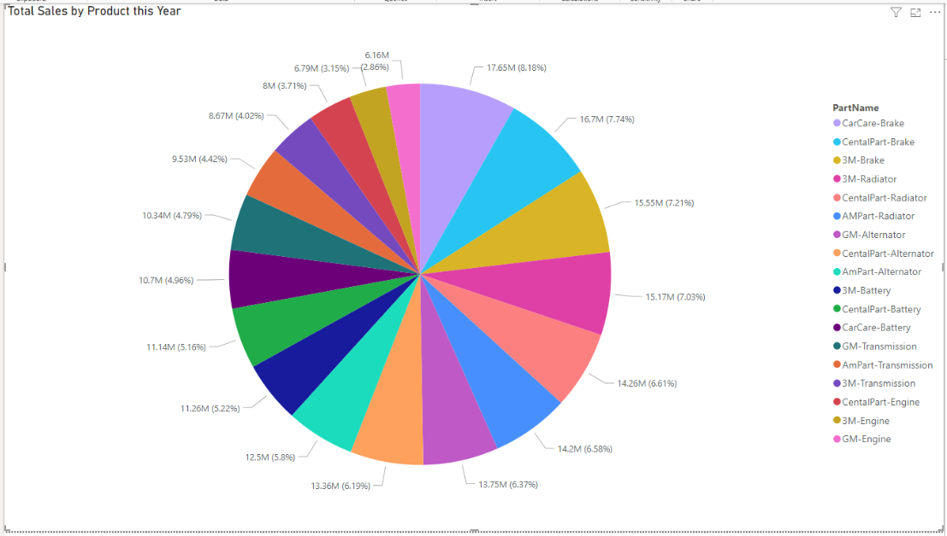
Visualization – Sales by part

Slide 9
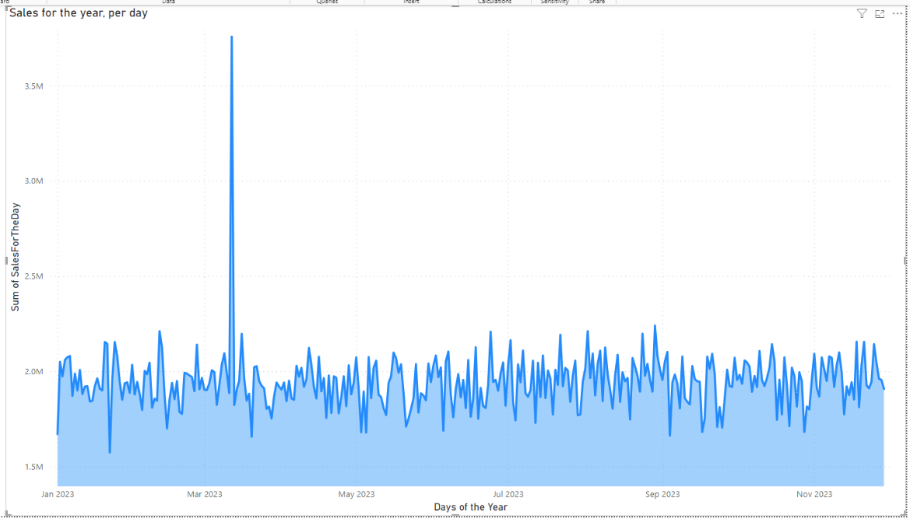
Visualization –daily sales over the year

Slide 10

Live demo

